Slide 1

Home Health Care Services
Project 2
Team: The Last Few
Shoujun Gu
Van Hoang
Shemelis Weldes

Slide 2
Project Overview
PURPOSE: To design and develop a website with search ability to provide users information on the types of health care services, quality ratings, and location of each service providers, so that the users can make informed decisions.
GOAL: Tell a story through data visualizations

Slide 3
Approach
The project process is as follows:
Step 1: Identify and put data together into a Database
Step 2: Identify chart and map types to tell data story
Step 3: Identify required tools and write codes
Step 4: Final Review
a) Identify set of data to use
b) Put the individual data files for each state into SQL Database
c) Combine all files into one csv file
d) Use Google API to obtain latitude and longitude information
a) Reviewed data and decided to use the following charts and maps to explain data:
Bar chart
Pie chart
Scatterplot
Clustered markers map
Category map
Heat Map
a) Used HTML/CSS, JavaScript, SQLite, Heroku, Python Flask, Census API, Google API, D3, Plotly, Leaflet, JQuery
b) EXCITING CODING TIME!!!
a) Perform final review to make sure requirements met:
Framework
Database
Program language
User-driven interaction
Dashboard
New JS library

Slide 4
Data
DATA | Data Source | Description
Service Providers | Data.Medicare.gov | Agencies that are certified and registered in a specific State to provide health care service
Service Type | Data.Medicare.gov | Nursing Care, Physical Therapy, Speech Pathology, and Home Health Aid
Ownership Type | Data.Medicare.gov | Government, Non-profit, or Proprietary
Location | Data.Medicare.gov | Locations of the providers in U.S.
Service Quality | Data.Medicare.gov | A standard that is used to measure service quality provided by a specific home care provider.
Other data for correlation purpose | Census | Population, Household Income, and Poverty Count

Slide 5
Methods
DB Engineering
Data Engineering
Data Exploration
Build
Flask APP & Visuals
1st Import original Home Health care CSV (20 columns) & convert to GeoJSON
2nd latlong from Google map API endpoint by Address
3rd Demographic data from Census API endpoint (15 columns)
4th Merge all the data
1st
Create ORM Class using SQL ALCHEMY
2nd
Append the main merged CSV to the ORM table (table class)
3rd
Create Homecare.sqlite.db
Reflected the Homecare.db
Data Manipulation in Pandas
Build Function for the python Flask API endpoints
Render Templates HTML
Build queries and served up data
Build interactive :
Charts(Bar, Pie)
Scatter plot
Clustered markers group map
Category map
Heat Map

Slide 6
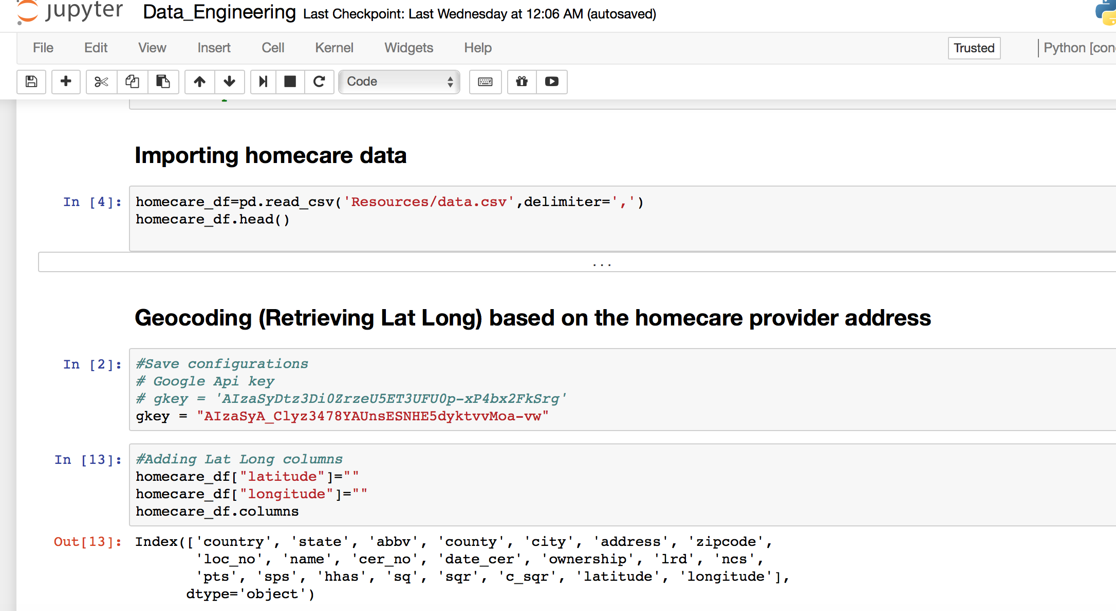
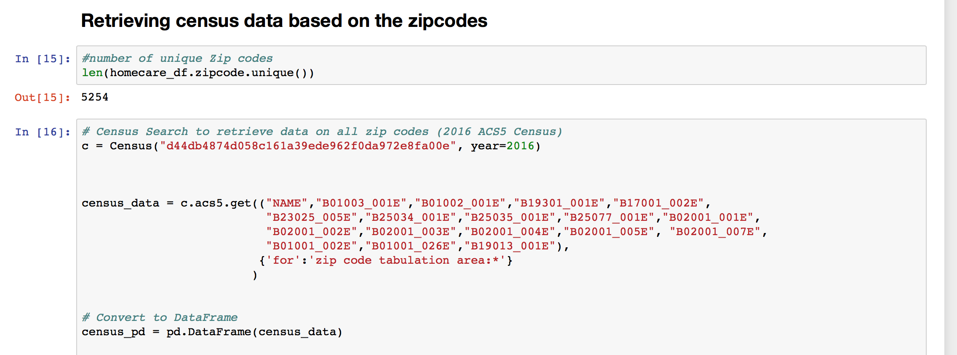
Data collection and manipulation

Slide 7
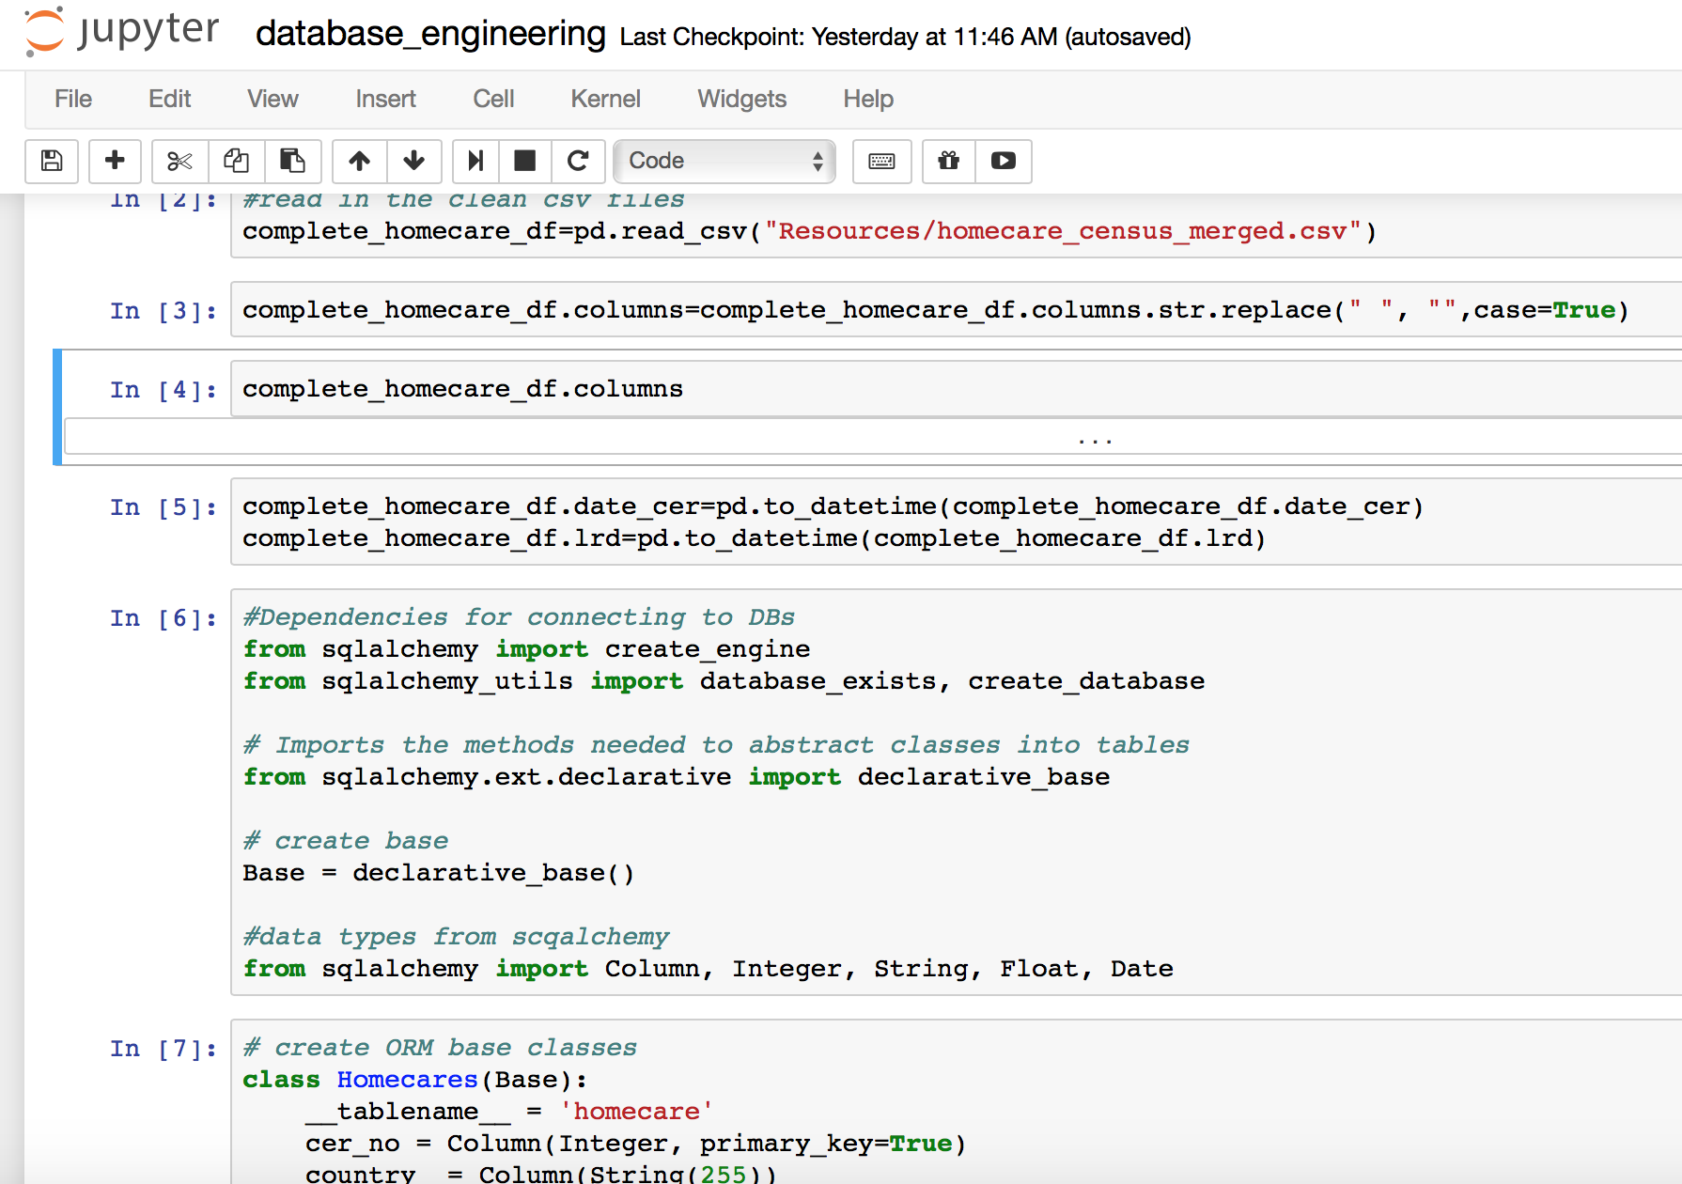
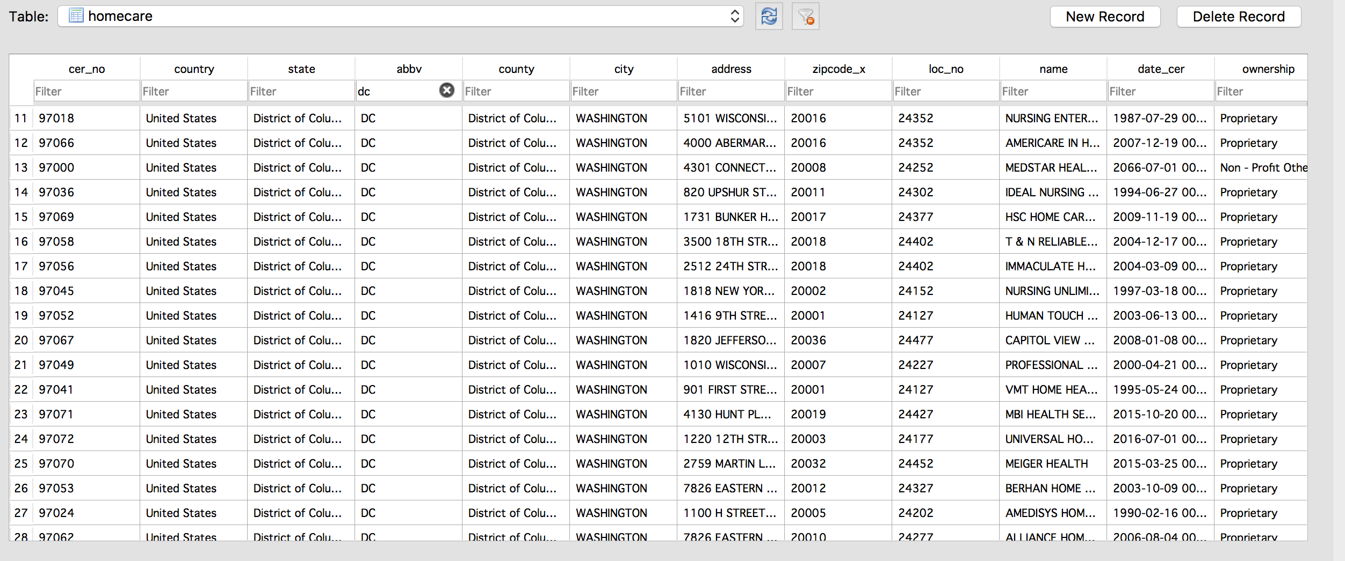
SQLite Db

Slide 8
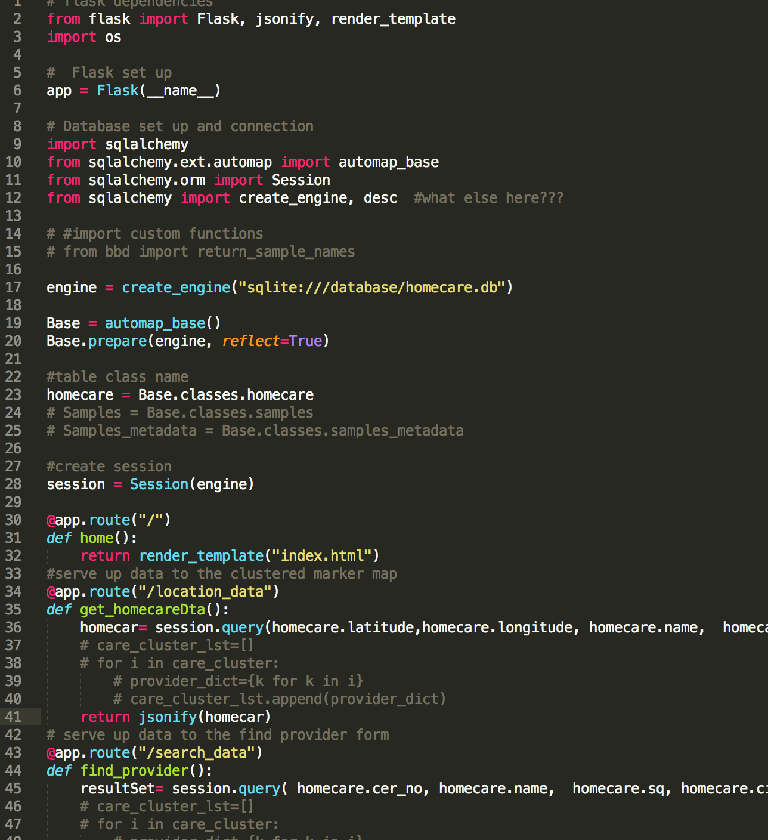
Flask API Endpoints

Slide 9
What we do next?
Home health care provider comparison based on
Service quality scores of individual providers against <State> average and National score
Track changes of the service quality score over years
Visualize the comparison

Slide 10
Link to Charts
Map: localhost
Bar/pie charts: https://shoujungu.herokuapp.com/
Scatterplot: localhost

Slide 11
Question?

Slide 12
Resources
https://www.ehealthmedicare.com/about-medicare/home-health-agencies/
https://www.medicare.gov/homehealthcompare/search.html

